Slide 1
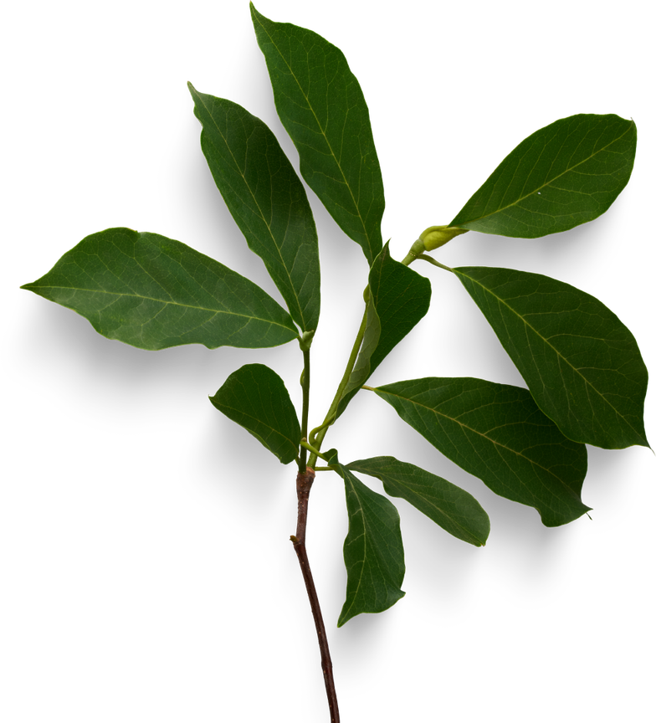
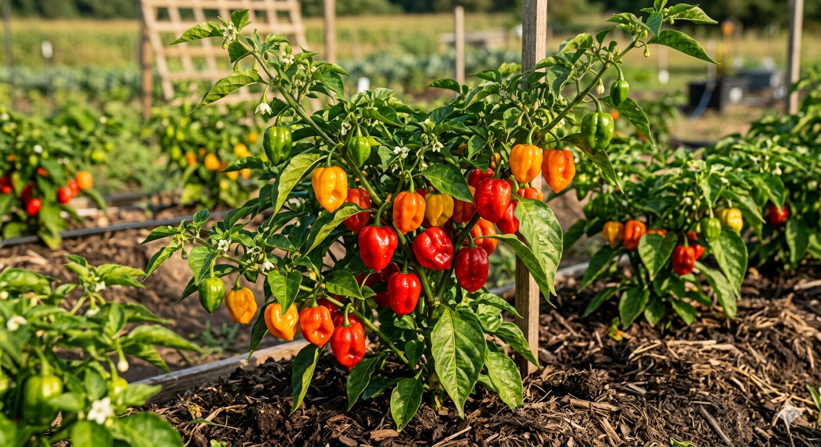

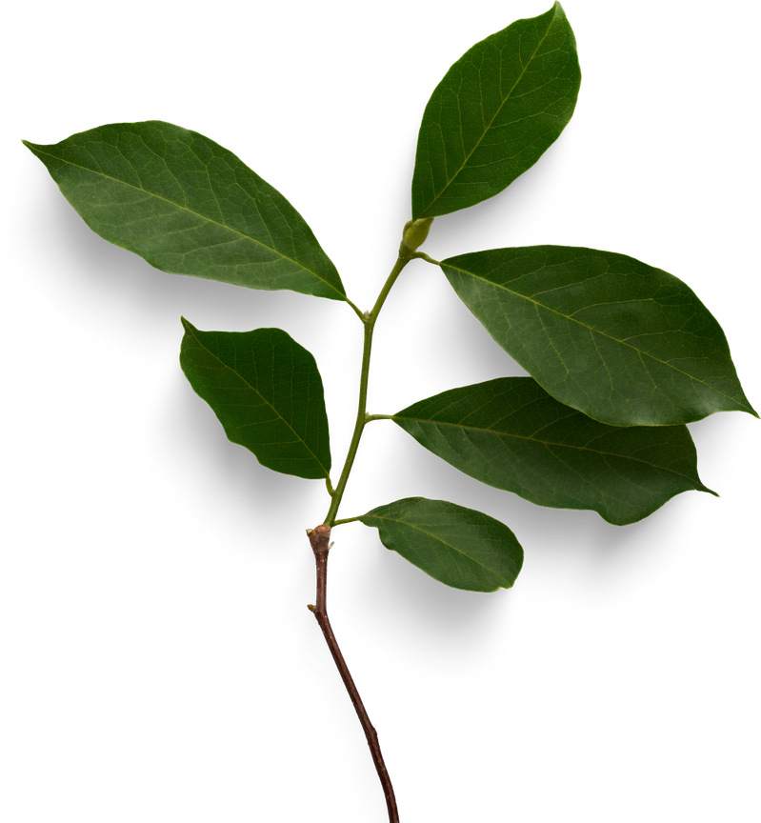
R26-IT-103
NAIMIRIS
A PROFIT-DRIVEN SMART FARMING APP FOR SCOTCH BONNET PEPPERS
PROGRESS PRESENTATION 2

Slide 2

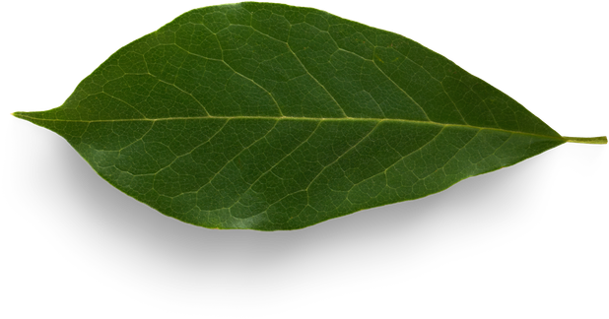
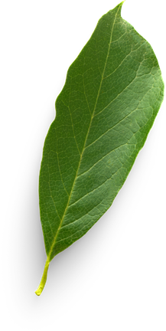
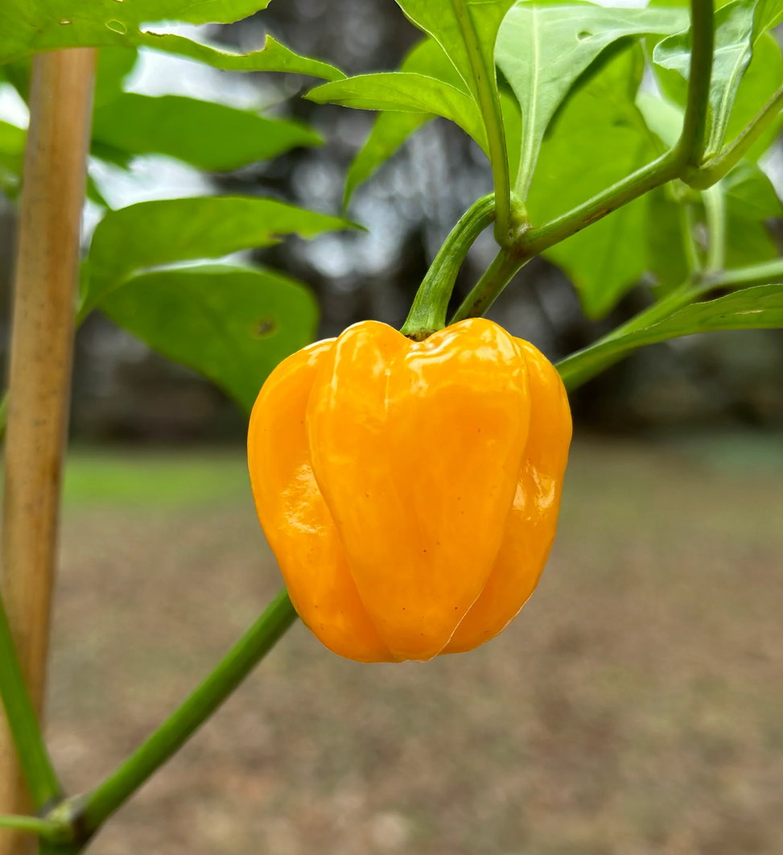

NAIMIRIS
Project Title - Naimiris: A Profit-Driven Smart Farming Model for Scotch Bonnet Peppers
Project ID - R26-IT-103
Supervisor - Ms Sadeepa Dushanthi Kuruppu
Core Supervisor - Ms Chathurangika Kahandawaarachchi
R26-IT-103
2

Slide 3

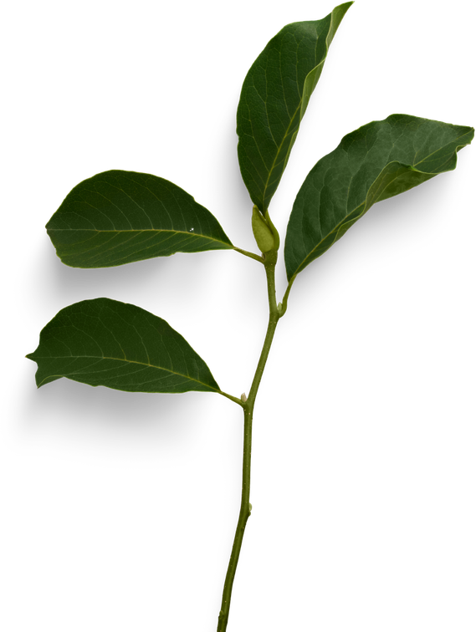
NAIMIRIS
INTRODUCTION
Agriculture is a key sector in Sri Lanka, but many small-scale farmers still use traditional methods which lead to low profit and high risk. NAIMIRIS is a smart farming app designed for farmers with less than 1 acre of land who want to earn better income from farming. The system provides highly accurate, crop-focused guidance for Scotch Bonnet pepper farming, delivering insights and strategies that are more precise and practical than common farming advice. NAIMIRIS helps farmers reduce risk, increase yield, and turn farming into a profitable business.
R26-IT-103
3

Slide 4
NAIMIRIS
WHO CAN BENEFIT FROM NAIMIRIS?
Aspiring Agricultural Investors
  Check land, cost, risks, and possible profit before investing.
  Follow complete farming guidance from planting to harvesting.
  Reduce losses through early pest and disease detection.
Existing Farmers
  Monitor crop growth and identify problems early.
  Improve farming decisions using smart recommendations.
  Increase crop yield and income.
IT2271464 KUMARAGE K J B HR26-IT-103
9

Slide 5

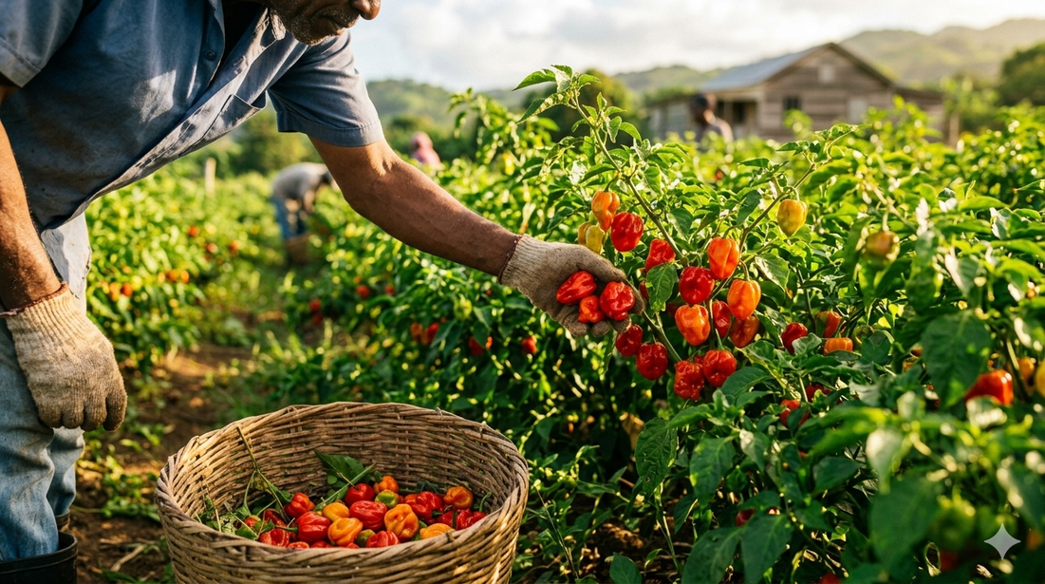
NAIMIRIS
THE PROBLEM
Existing Problems
• Traditional farming focuses on production, not profit
• Low income for small-scale farmers
• Lack of accurate farming guidance
• Dependence on middlemen and poor market access
• Small land sizes limit profitability
Why This is Important
• Farmers work hard but earn low profit
• Farming becomes high risk and unstable
•Farmers cannot treat farming as a profitable business
• Young people avoid agriculture
• Need for a smart, profit-focused farming system
R26-IT-103
5

Slide 6
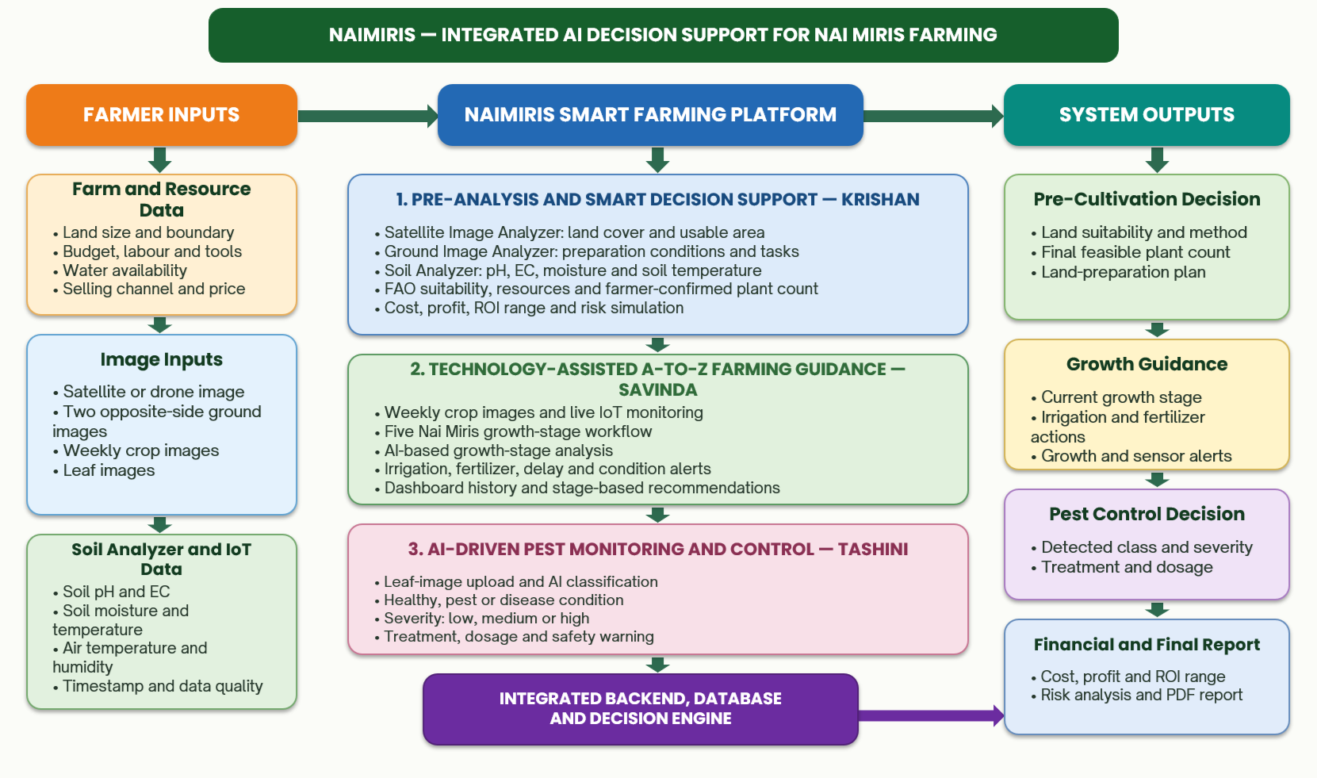
NAIMIRIS
SOLUTION OVERVIEW

Slide 7

NAIMIRIS
PRE-ANALYSIS & SMART
DECISION SUPPORT STAGE
IT22271464 - KUMARAGE K J B H
IT2271464 KUMARAGE K J B HR26-IT-103
7

Slide 8
NAIMIRIS
INTRODUCTION
  Starting Nai Miris farming without proper analysis can cause financial loss and resource waste.
  The system analyses satellite and ground images to identify usable land and required preparation work.
  It combines image results with soil sensor data, weather, budget, labour, and equipment details.
  It recommends the most suitable farming method: open field, greenhouse, or grow bags.
  It provides plant count, estimated cost, expected profit, ROI, and a practical cultivation plan.
Objective
•To help farmers and investors make low-risk and profitable decisions before starting Nai Miris cultivation.
IT2271464 KUMARAGE K J B HR26-IT-103
9

Slide 9
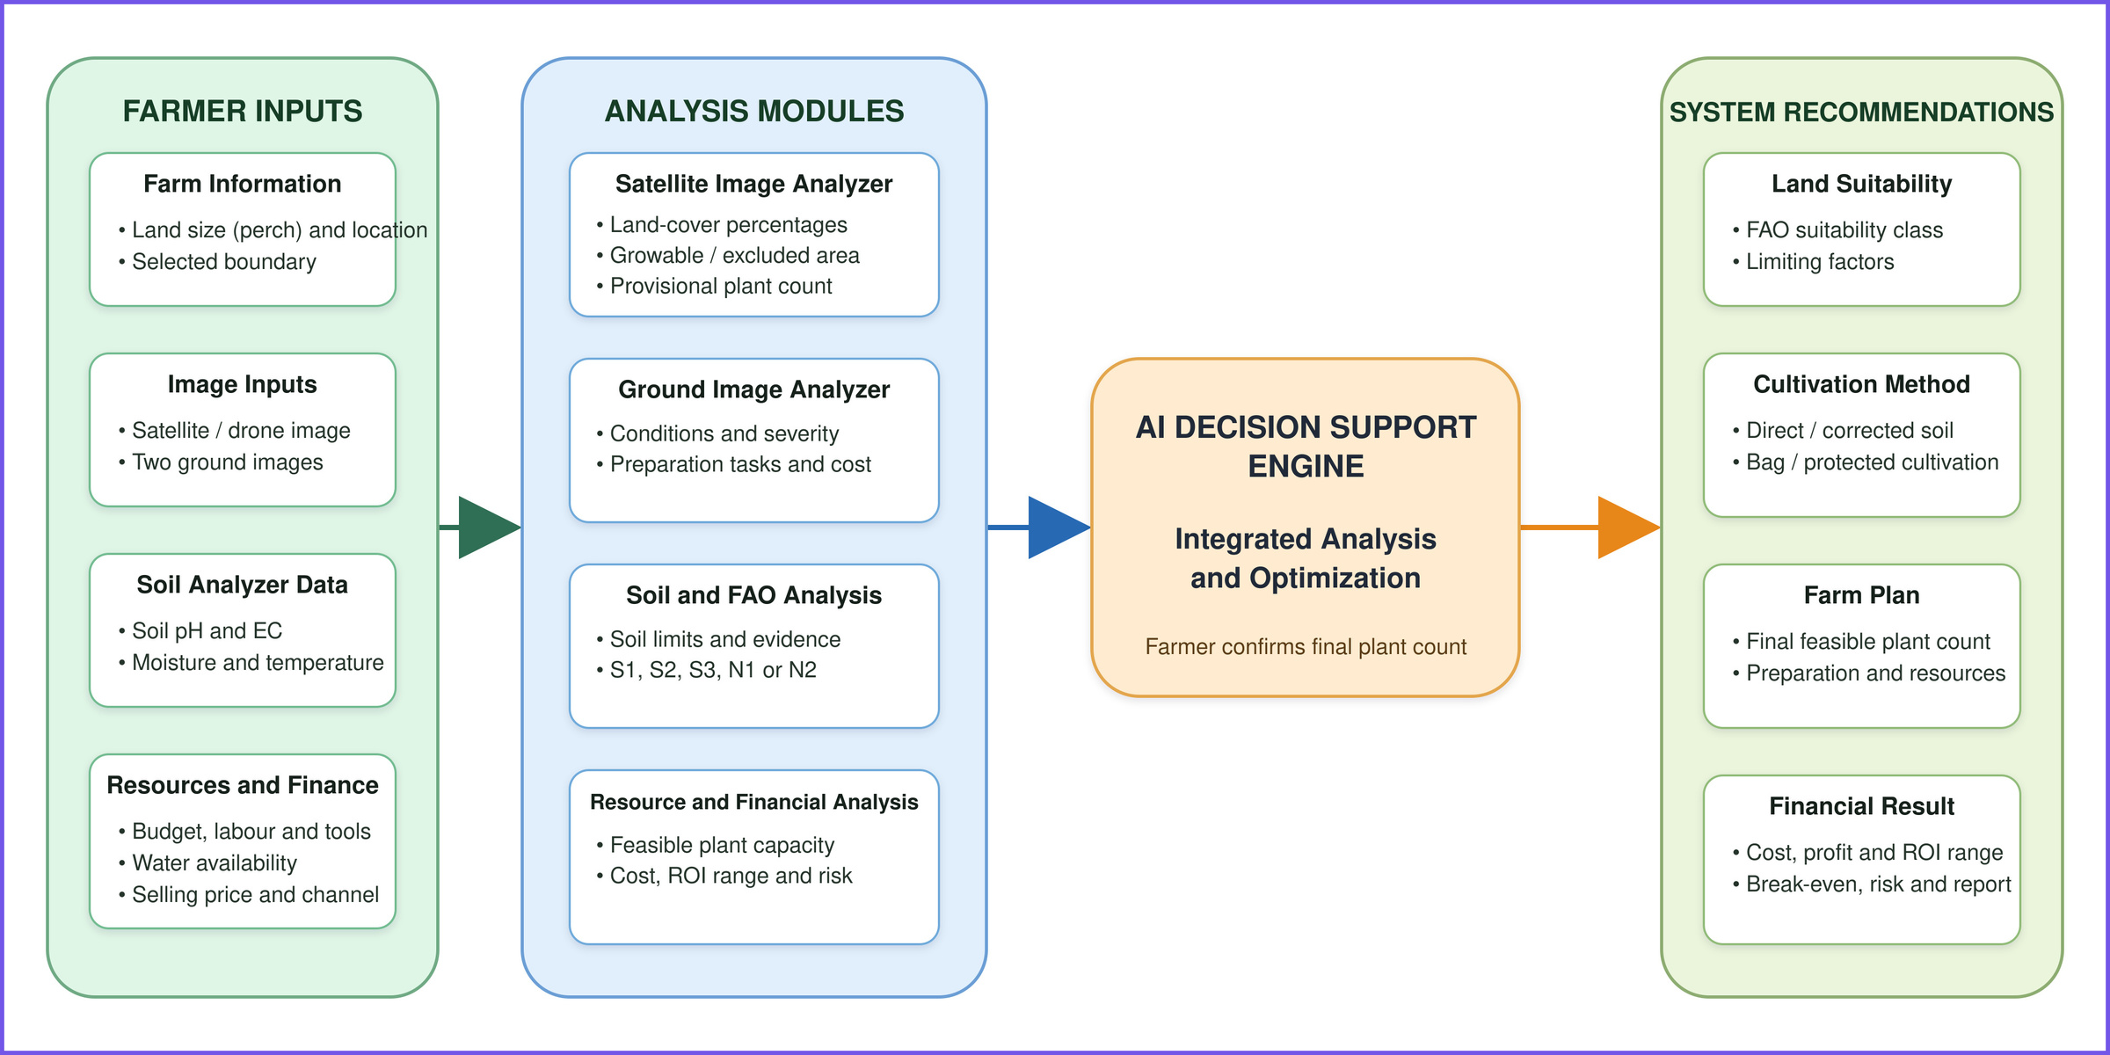
NAIMIRIS
SYSTEM DIAGRAM
IT2271464 KUMARAGE K J B HR26-IT-103
8

Slide 10
NAIMIRIS
CURRENT PROGRESS
AI IMAGE ANALYZERS
Model 1 – Satellite Image Analyzer
  Model: SegFormer-B2
  Type: PyTorch Semantic Segmentation
  Datasets: LoveDA and OpenEarthMap
  Detects eight land-cover classes
  Calculates growable area and provisional plant count
Model 2 – Ground Image Analyzer
  Model: SegFormer-B2
  Type: PyTorch Semantic Segmentation
  Detects grass, bushes, bare soil, trees, mud, water, debris and other areas
  Suggests preparation tasks, labour, equipment and cost
IT2271464 KUMARAGE K J B HR26-IT-103
10

Slide 11
NAIMIRIS
CURRENT PROGRESS
SMART DECISION SUPPORT
  Developed a saved step-by-step farmer workflow
  Added Soil Analyzer data: EC, moisture and temperature
  Added FAO suitability classes: S1, S2, S3, N1 and N2
  Analyzes budget, labour, equipment and water availability
  Calculates cost, revenue, profit, ROI range and financial risk
  Generates the final farming recommendation and PDF report
IT2271464 KUMARAGE K J B HR26-IT-103
10

Slide 12
NAIMIRIS
FUTURE WORK
NEXT STEPS
  Conduct real-world testing in Sri Lankan Nai Miris farms
  Collect feedback from farmers and agricultural experts
  Complete integration and test the full system end-to-end
IT2271464 KUMARAGE K J B HR26-IT-103
11

Slide 13

NAIMIRIS
TECHNOLOGY-ASSISTED
A-TO-Z FARMING GUIDANCE STAGE
IT22124630 - SAVINDA R.MD
IT22124630 SAVINDA R M D R26-IT-103
12

Slide 14
NAIMIRIS
INTRODUCTION
  Agriculture still relies on manual crop monitoring, making it difficult for farmers to detect growth and environmental problems early.
  Modern technologies such as the Internet of Things (IoT) and Artificial Intelligence (AI) provide new opportunities for smart farming.
  This research develops a technology-assisted farming guidance system for Scotch Bonnet pepper (Nai Miris) cultivation by integrating IoT environmental sensors with AI-based image analysis.
  By analyzing weekly crop images and real-time sensor data, the system identifies growth conditions and provides recommendations such as irrigation or fertilizer adjustments to improve crop productivity.
Objective
• To develop an AI- and IoT-based smart farming system that monitors crop growth stages and environmental conditions to provide technology-assisted cultivation guidance for Nai Miris farming.

Slide 15
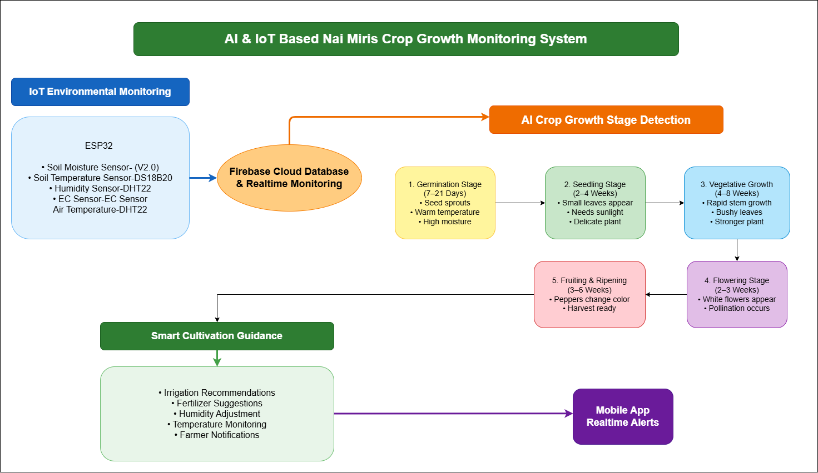
NAIMIRIS
SYSTEM DIAGRAM
IT22124630 SAVINDA R M D R26-IT-103
13

Slide 16
NAIMIRIS
CURRENT PROGRESS
IOT GROWTH MONITORING
  Implemented the complete five-stage growth-monitoring workflow
  Connected IoT sensors using ESP32
  Collects temperature, humidity, soil moisture, soil temperature and EC
  Sends real-time sensor data to Firebase
  Implemented stage-based condition analysis
  Generates environmental alerts and farming recommendations
  Developed a dashboard for readings, growth status and notifications
IT2271464 KUMARAGE K J B HR26-IT-103
15

Slide 17
NAIMIRIS
CURRENT PROGRESS
AI IMAGE MODELS
Seedling Emergence Stage
  Implemented YOLOv8n Object Detection
  Detects emerged seedlings and provides count, location and confidence
Flowering Stage
  Implemented a YOLO-based Object Detection model
  Detects visible flowers and young fruits
  Provides count, location and confidence
Fruiting & Ripening Stage
  Implemented YOLO11s Object Detection
  Detects unripe and ripening fruits
  Calculates total fruit count and ripening percentage
  Approximately 9.4 million parameters and 21.4 GFLOPs
IT2271464 KUMARAGE K J B HR26-IT-103
15

Slide 18
NAIMIRIS
FUTURE WORK
NEXT STEPS
  Conduct real-world testing in Sri Lankan Nai Miris farms
  Collect feedback from farmers and agricultural experts
  Complete integration and test the full system end-to-end
IT2271464 KUMARAGE K J B HR26-IT-103
11

Slide 19

NAIMIRIS
AI-DRIVEN PEST MONITORING AND CONTROL SYSTEM
IT22212740 - GUNAWARDANA T.D.A
IT22212740 GUNAWARDANA T D A R26-IT-103
17

Slide 20
NAIMIRIS
INTRODUCTION
  Pest attacks are a major challenge in Scotch Bonnet pepper (Nai Miris) cultivation in the Sri Lankan wet zone.
  Traditional monitoring is manual and often delayed, causing crop loss.
  This research proposes an AI-based pest monitoring system that detects pests from leaf images, assesses severity, provides accurate pesticide recommendations, and reduces chemical overuse.
  It helps farmers make timely, data-driven decisions and improve yield.
Objective
• Develop an AI-based pest monitoring system for Scotch Bonnet pepper (Nai Miris) that detects pests, evaluates infestation severity, and provides precise treatment recommendations.
IT22212740 GUNAWARDANA T D A R26-IT-103
18

Slide 21
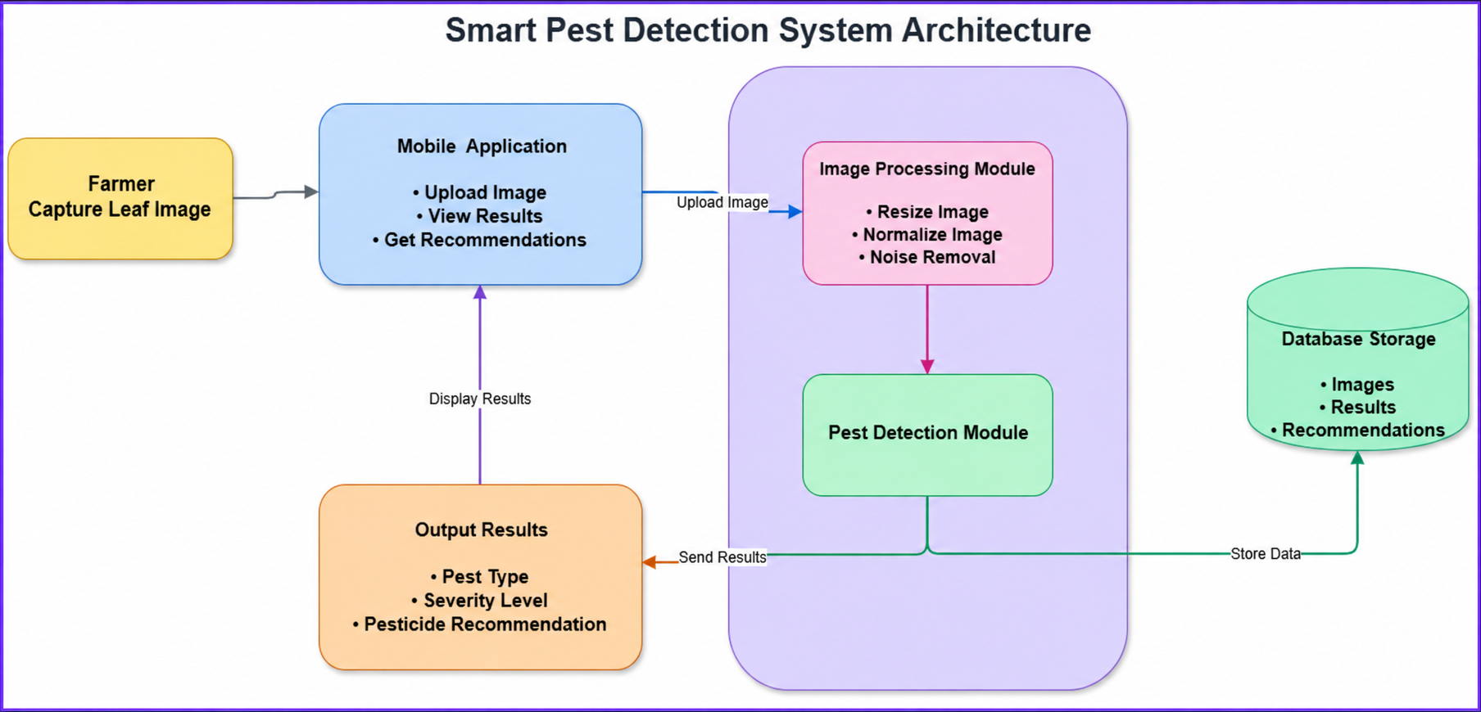
NAIMIRIS
SYSTEM DIAGRAM
IT22212740 GUNAWARDANA T D A R26-IT-103
19

Slide 22
NAIMIRIS
CURRENT PROGRESS
Model Details
  Model: efficientnetb0 Image Classification
  Trained using healthy and infected leaf images
  Identifies the pest or disease category from a leaf image
  Provides a confidence score for each prediction
Current Function
  User can upload or capture a Nai Miris leaf image
  Backend processes the image using the trained model
  Displays the original image, detected class and confidence
  Prediction flow is connected with the mobile application
  Treatment recommendation logic is currently being integrated
IT2271464 KUMARAGE K J B HR26-IT-103
20

Slide 23
NAIMIRIS
FUTURE WORK
NEXT STEPS
  Conduct real-world testing in Sri Lankan Nai Miris farms
  Collect feedback from farmers and agricultural experts
  Complete integration and test the full system end-to-end
IT2271464 KUMARAGE K J B HR26-IT-103
11

Slide 24
NAIMIRIS
COMMERCIALIZATION PLAN
The Smart Farming Decision Support System will be offered as a subscription-based platform for farmers and agricultural businesses. Users can access AI-powered farming recommendations, monitoring, and analysis through monthly or yearly plans. The system can also integrate with IoT sensors to collect real-time farming data and improve decision-making. Revenue will be generated through subscriptions, premium services, and agricultural partnerships.

Slide 25
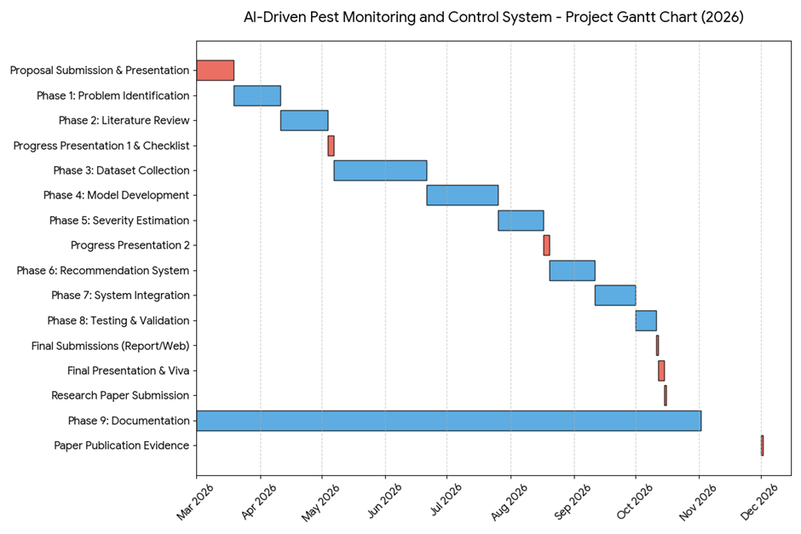
NAIMRIS
WORK BREAKDOWN STRUCTURE
R26-IT-103
23

Slide 26
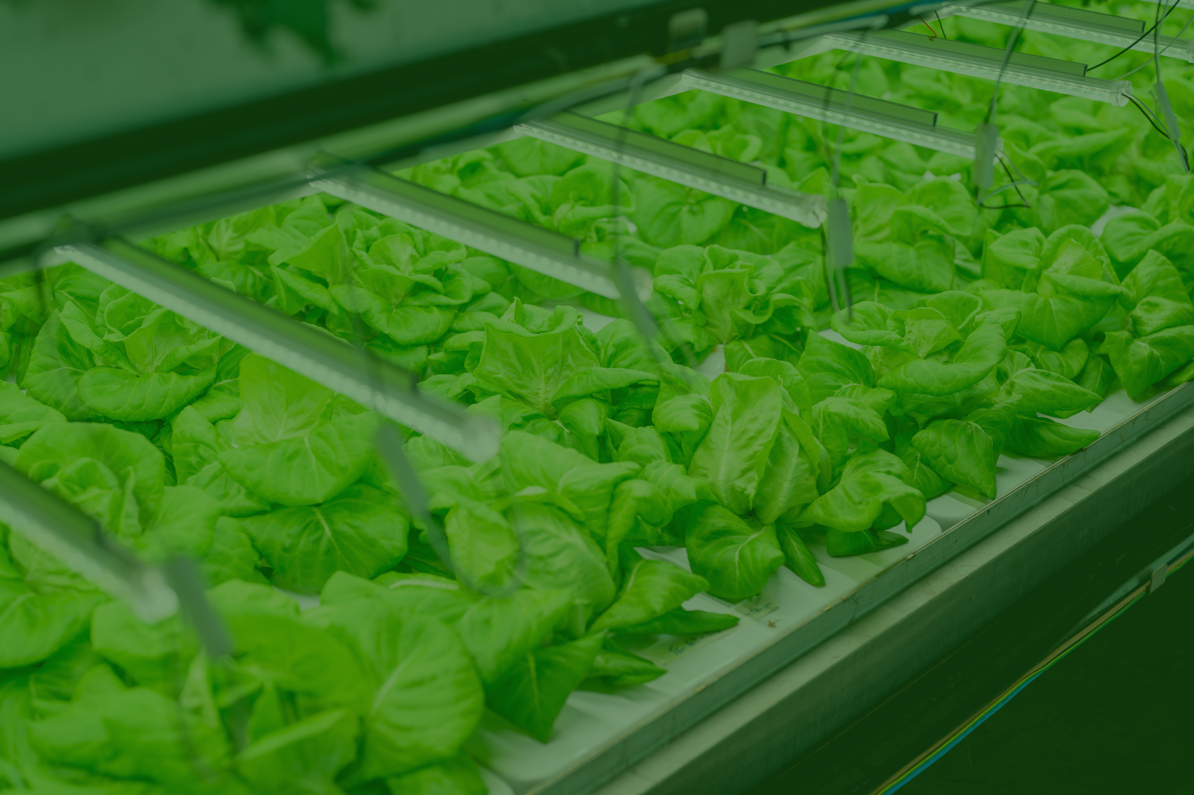
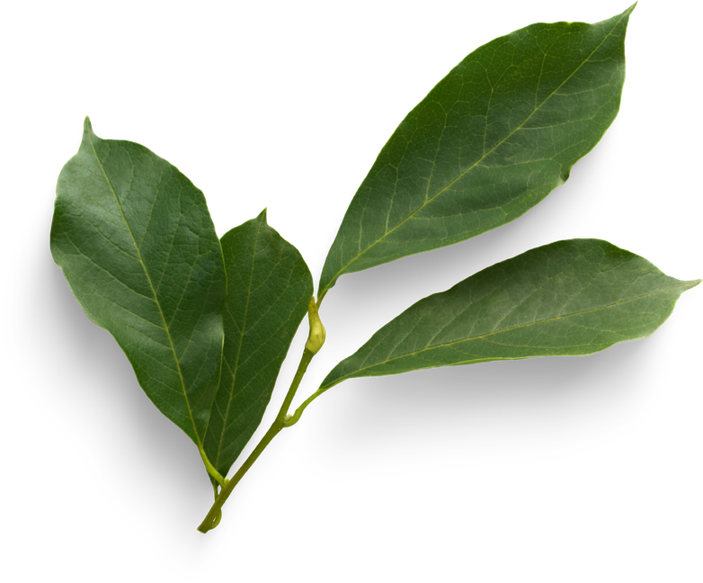
THANK YOU

